Slide 1
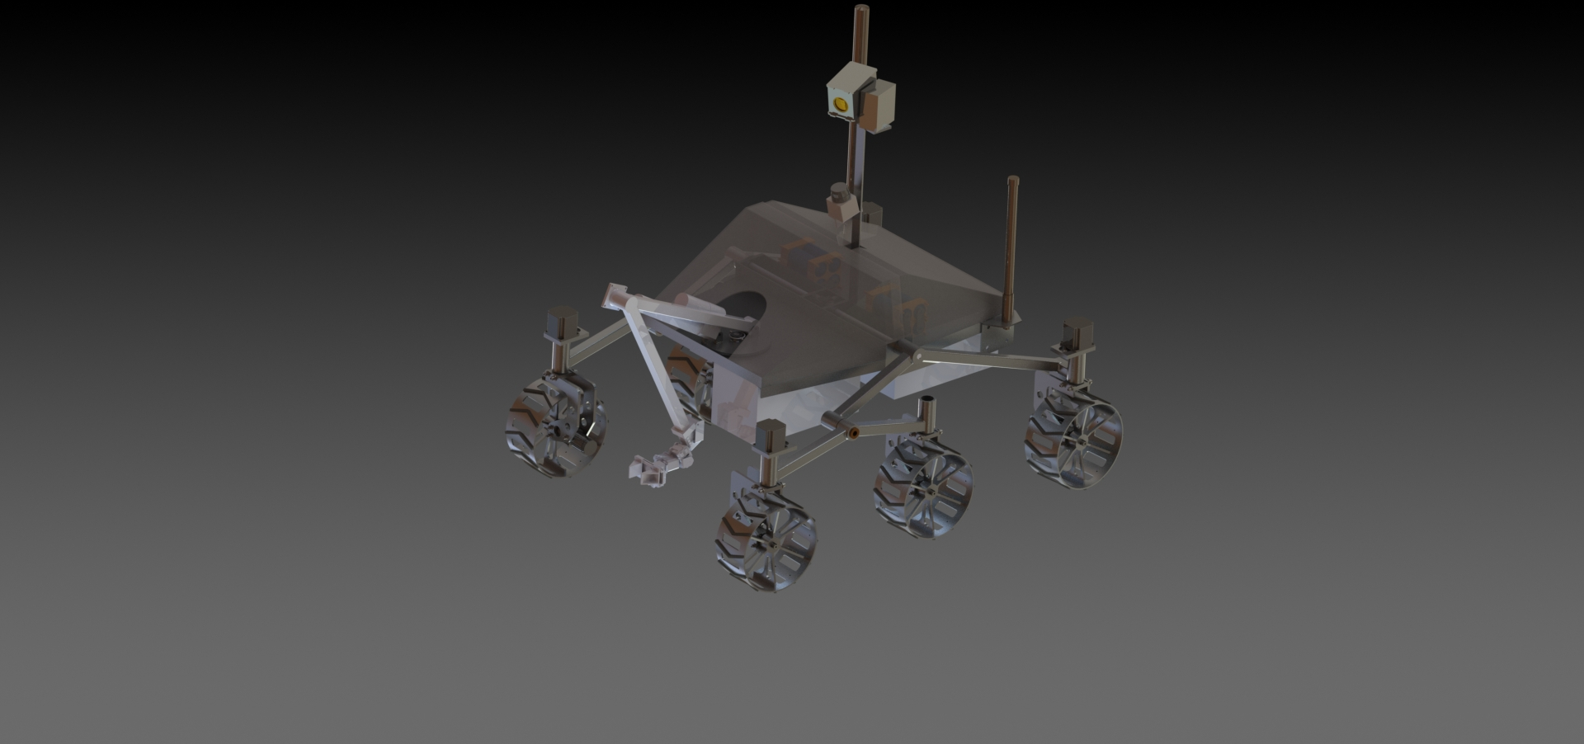



Midterm Design Review
Spring 2013

Slide 2
Mission Statement
MAVRIC is a project aimed at designing and building a functional “mars rover” capable of doing a set of various tasks that will be presented in a competition called the University Rover Challenge. MAVRIC also creates an opportunity for engineering students to help design and build a rover, and get a real-world, applicable knowledge that is vitally important for future endeavors.

Slide 3
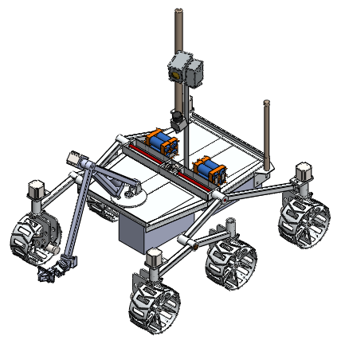
MAVRIC
Project Advisor
Matt Nelson
Team Members
Josh DeLarm - Team Leader
Josh Boyer - Aerospace Engineer
Timothy Miner - Civil Engineer
Alexander Maxwell - Computer Engineering
Sarah Biver – Chemical Engineer
James Bove – Aerospace Engineer
Jeffrey Christensen – Mechanical Engineer
Carlos Negrin-Bolanos – Aerospace Engineer
Saimanoj Siddula – Aerospace Engineer
Graham Weilein – Aerospace Engineer

Slide 4
Objectives
Soil Sample Task: Identify an area worth sampling, collect and return soil sample from identified area, perform analysis and present results.
Terrain Traversal Task: Navigate complex terrain with reduced RF performance.
Astronaut Assistance Task: Deliver multiple payloads of unknown configuration to specified coordinates.
Construction Task: Manipulate switches and cables on an access panel in specified order as well as clean solar panels to increase electrical output.
Presentation Task: Present design decisions, methodology and budget.

Slide 5
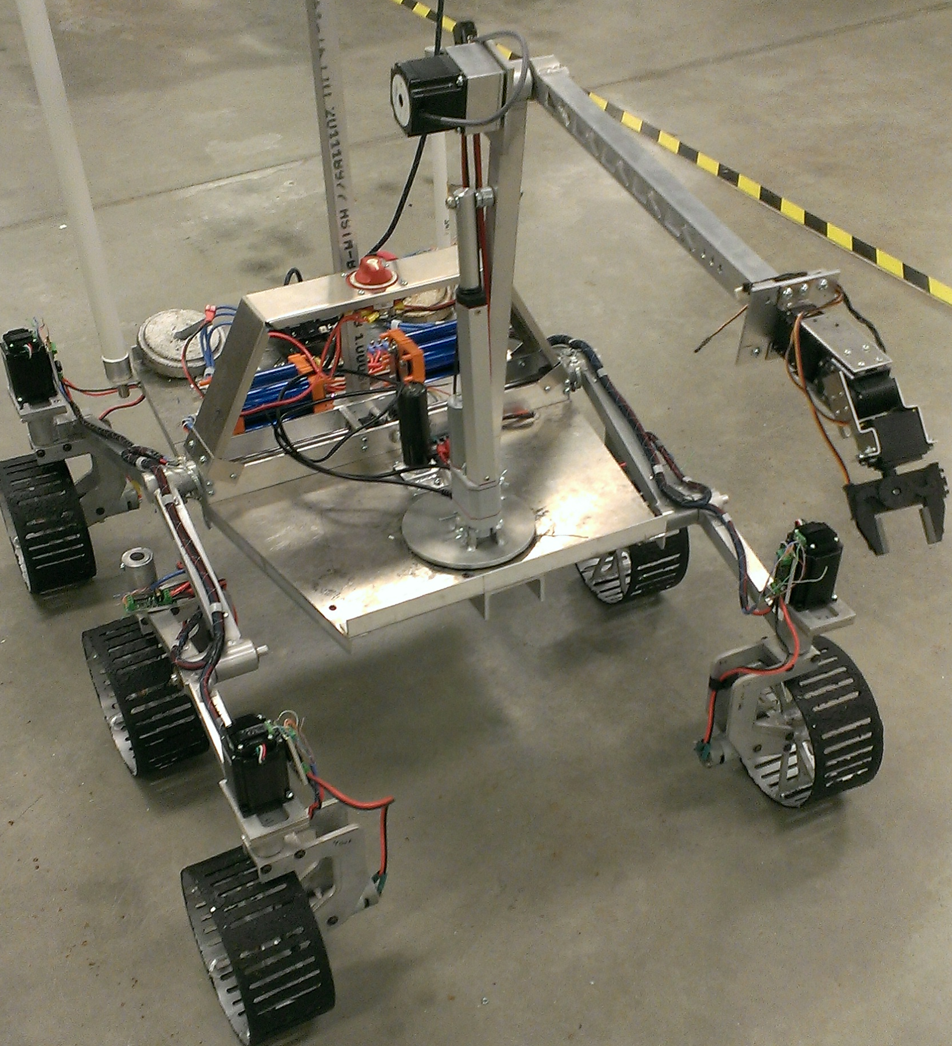
Rover So Far

Slide 6
Current Progress
Rudimentary driving system in place. Currently uses skid steering in order to move.
Wireless communication to rover established.
Web based command platform developed for versatile, wireless control.
Several subsystems in redesign phase.

Slide 7
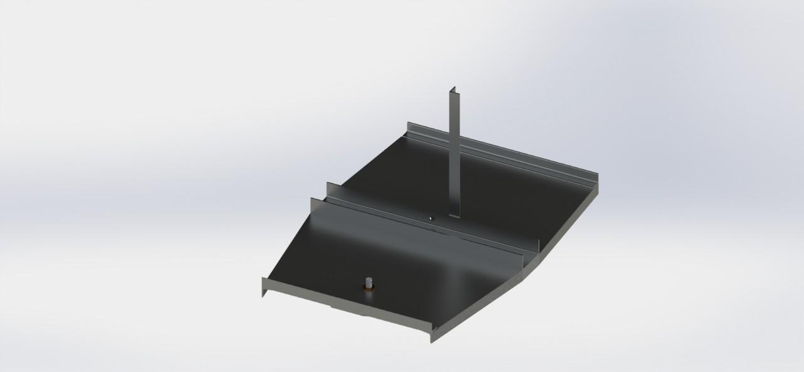
Preliminary Design of Chassis
Features
Two C channels make up a rigid platform on which to attach the platform.
Payloads deployed from under forward and rear shelves.
Bolt together construction for easy repair.
Lightweight design.
Composite Shell to cover electronics.

Slide 8
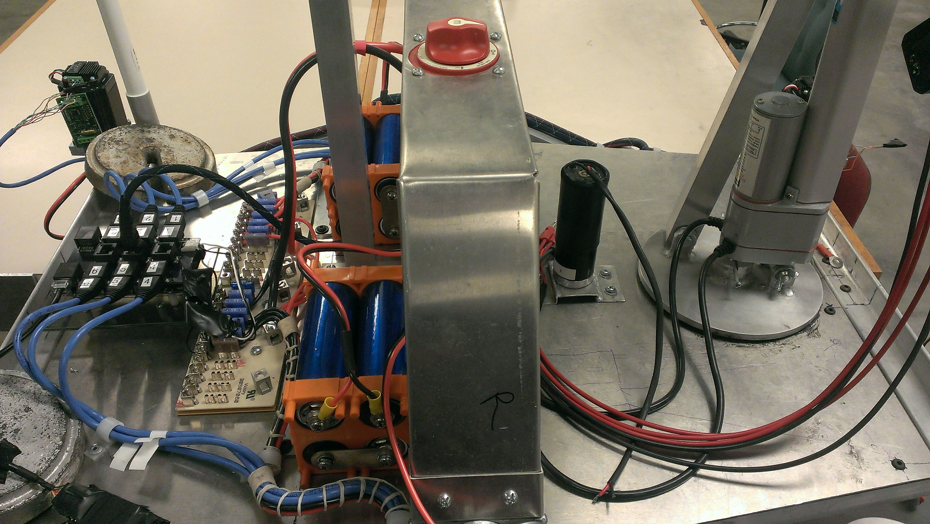
Current Chassis
On/off switch structure above differential for easy access.
Back half
Electronic boards/wires
Batteries
Camera mount
Payload deployment latches (Not pictured)
Front half
Robotic Arm
Payload deployment latches (Not pictured)

Slide 9
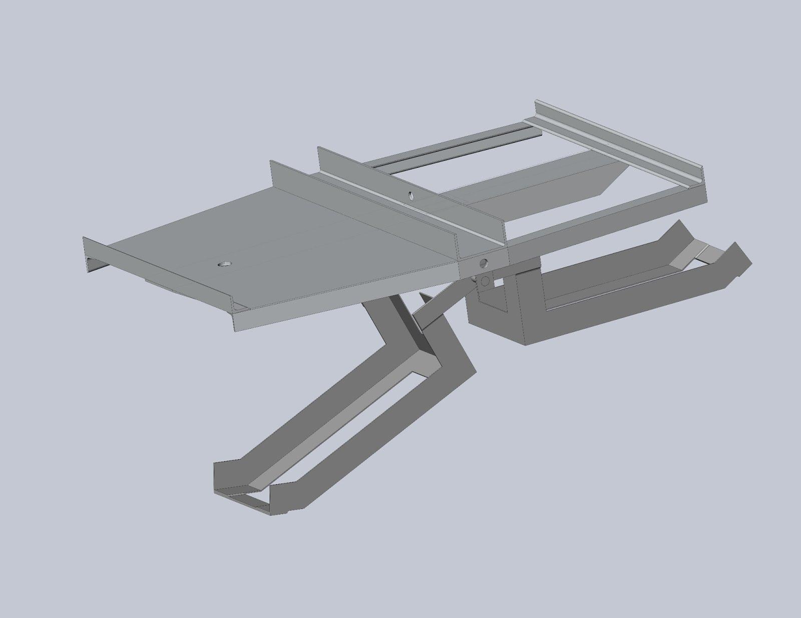
Preliminary Design of Payload Deployment
Four deployable undercarriage aluminum boxes.
One deployable box on rover shell.
Centralized pivot point under differential.
Deployment latches for quick release and retrieval.

Slide 10
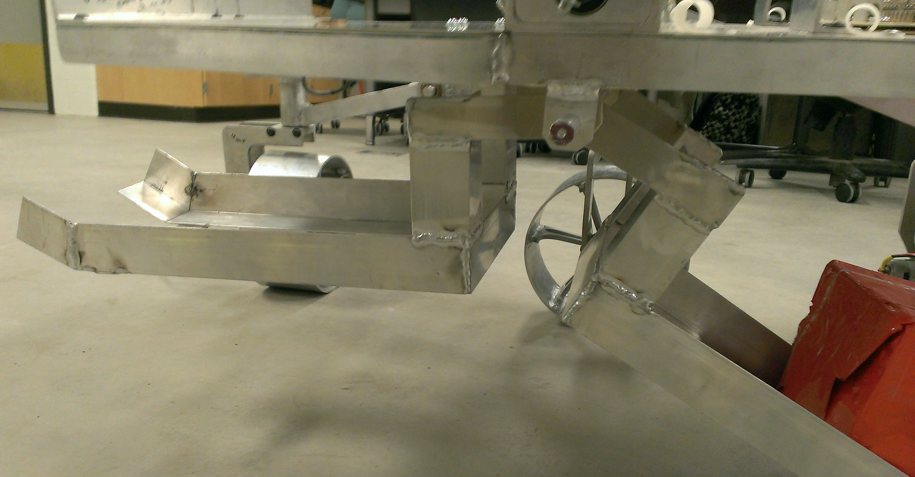
Current Payload Deployment
Simple aluminum welded structure.
Designed for box to contact ground when deployed.
Deployment latches still in design phase.

Slide 11
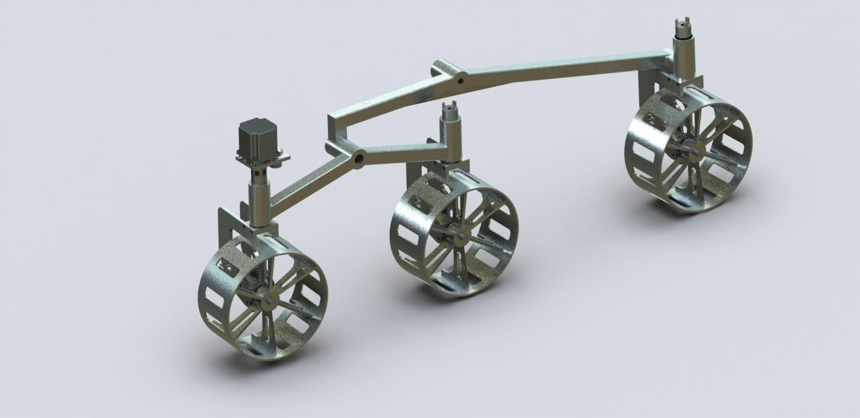
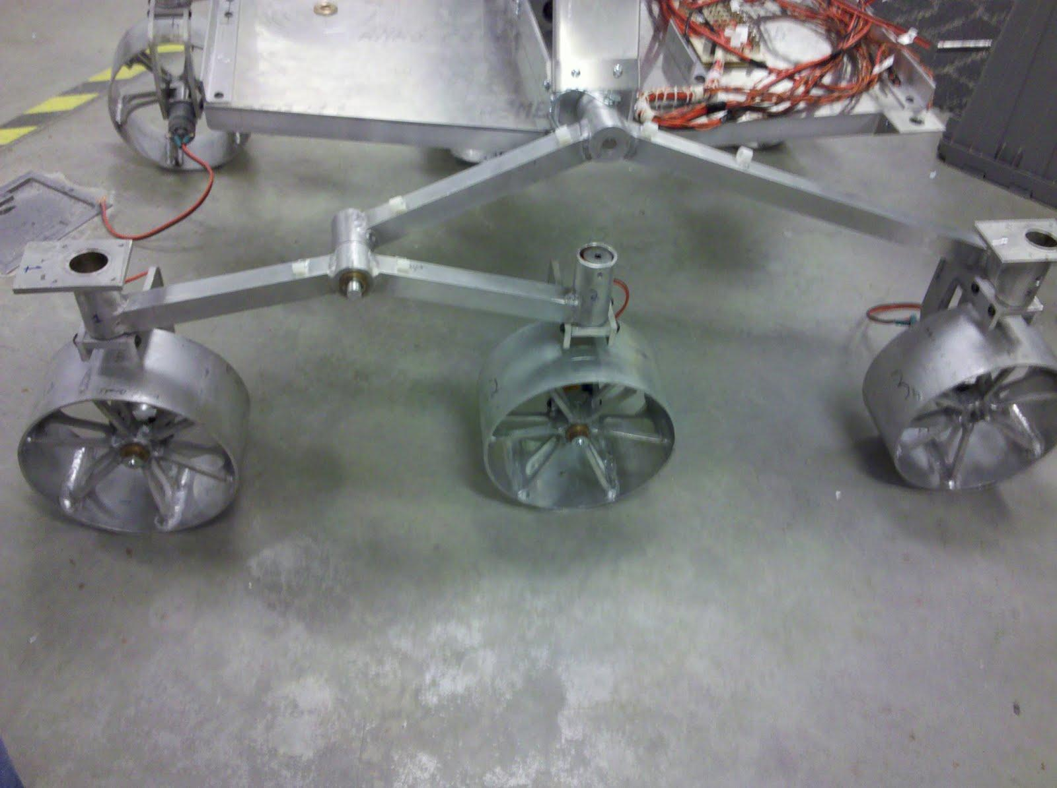
Rocker-Bogie Suspension
Light Design allows for overall lighter rover than previous track design.
Combination of Rockers and bogies allows for superior stability and maneuverability.
Design was much easier and much more cost effective to manufacture than the previous track design.

Slide 12
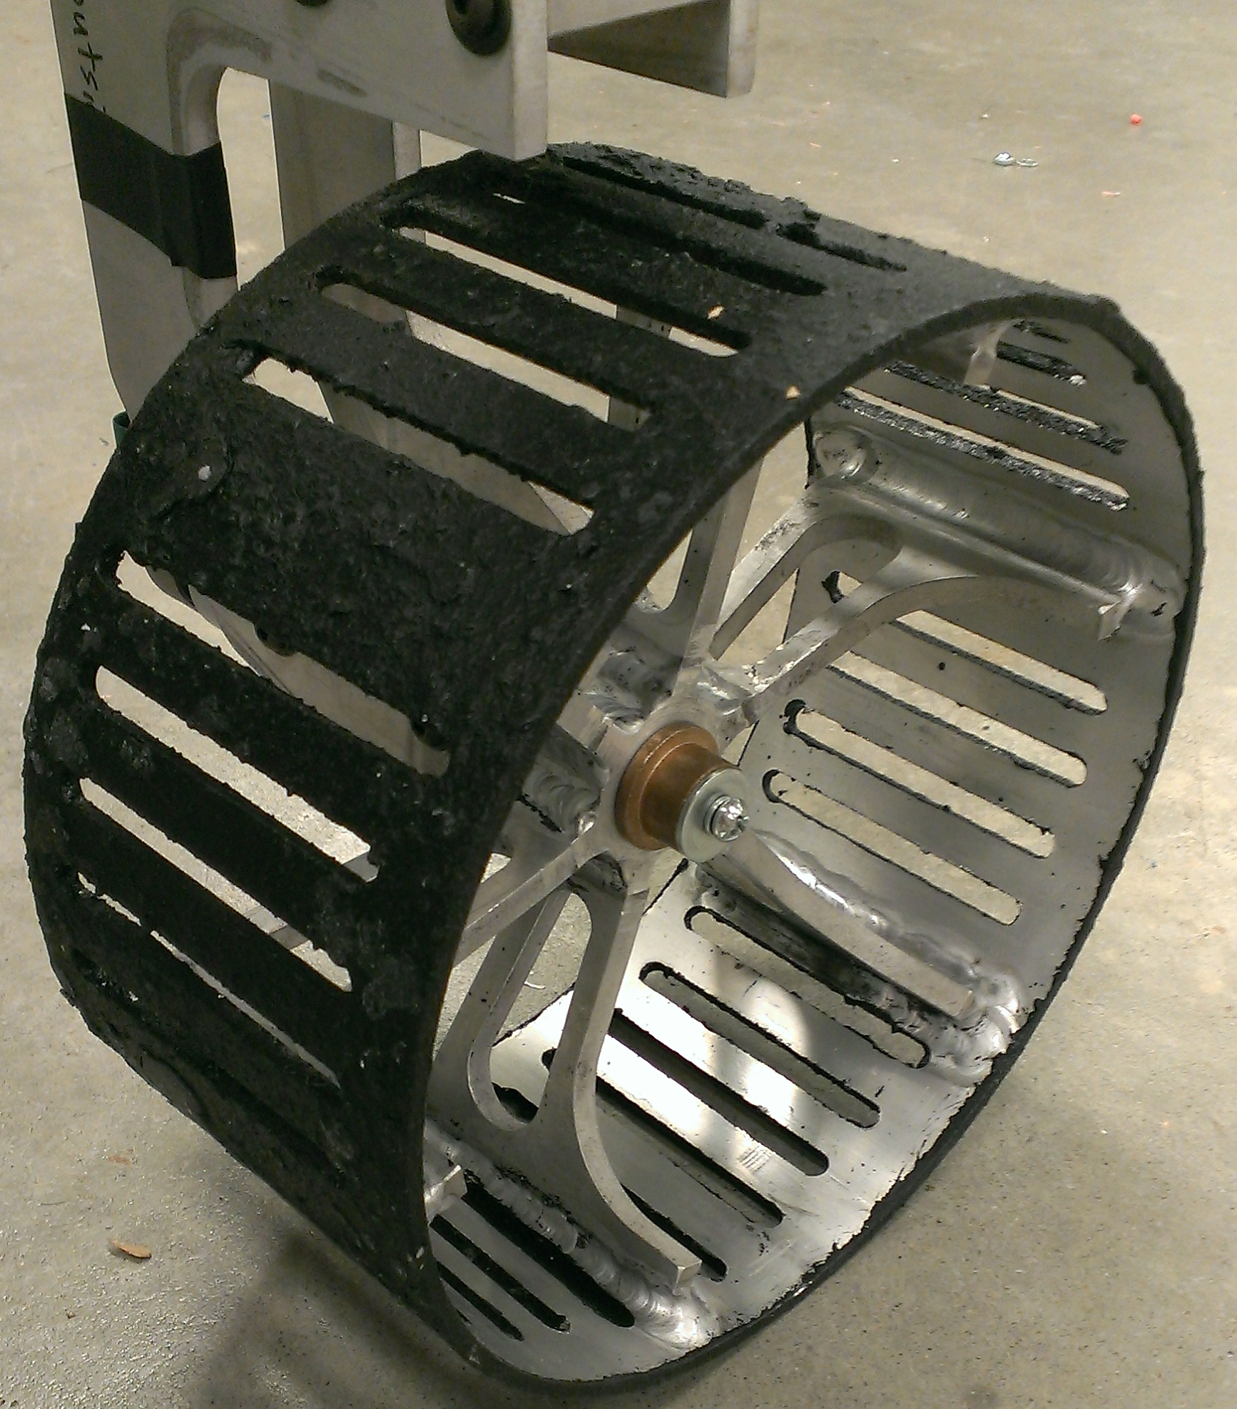
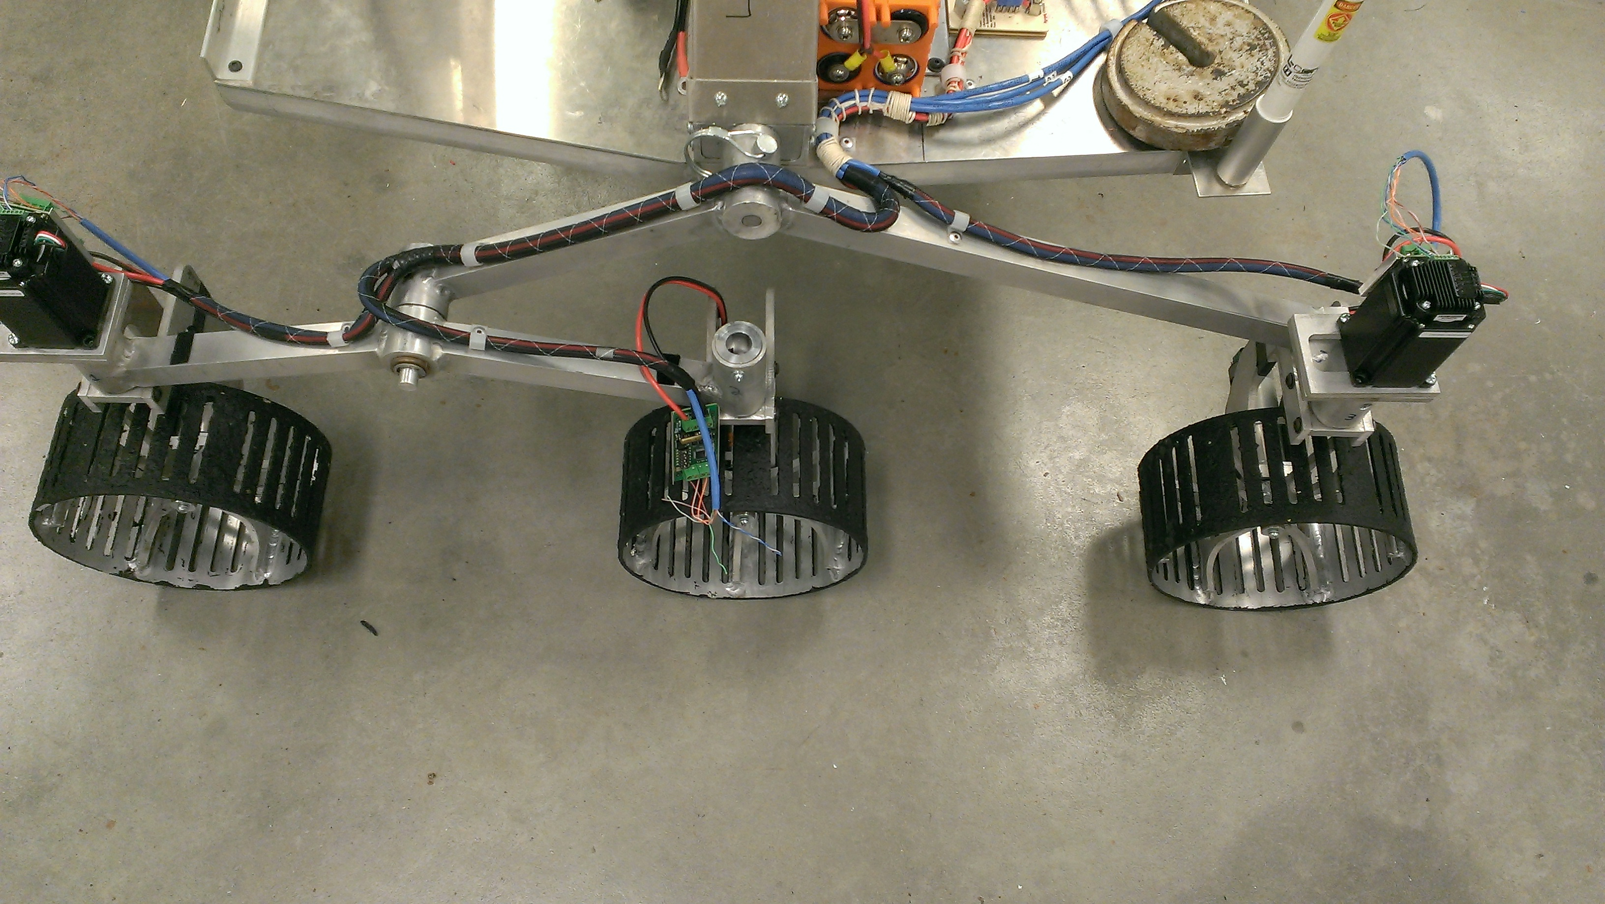
Wheels
Custom built in-house.
Custom cost less than buying pre-built.
Lighter custom design was possible when making our own.
Rubber coating applied to add grip and traction.
Current wheels are a finished product.

Slide 13
Driving
Each wheel is independently driven by a motor.
Allows for improved traction on uneven terrain.
Current driving system is more effective at handling terrain and saving weight.
Steering
While driving, the front and back wheels pivot in unison to steer.
To perform tight turns the wheels each turn in towards each other.

Slide 14
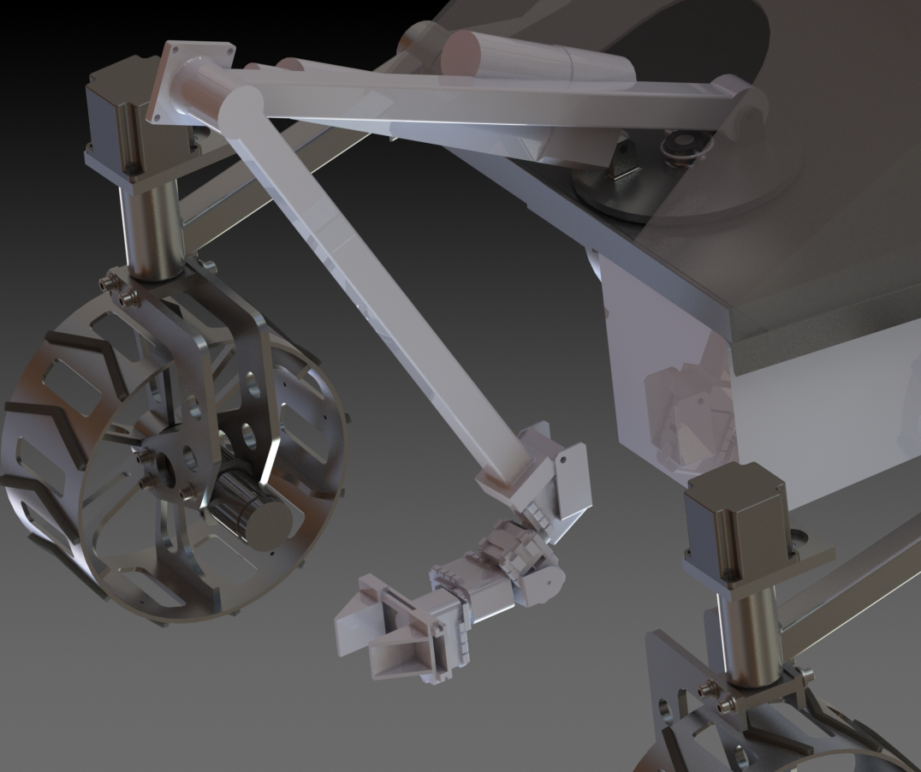
Arm Design
Arm lengths based on 2-D sketches.
Rover Dimensions and task specifications accounted for.
End plate allows for multiple tools to be attached for the different tasks.
Spherical coordinates used over Cartesian to make the arm more moveable.

Slide 15
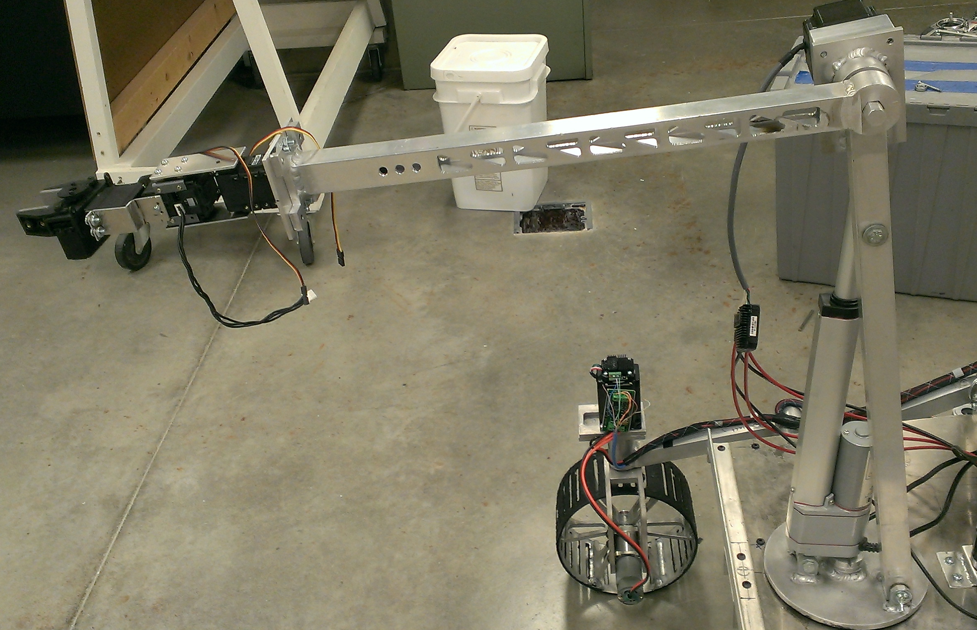
Arm
Aluminum body.
Mounted to rotary plate with 360° range.
Linear movements controlled by a linear actuator.
- 35 lbs of force.
- Rapid feed rate.
- Approx. 90° vertical range.
Arm joint controlled by stepper motor and gearbox.
- Theoretical 360° range, but limited to 340° due to physical constraints.

Slide 16
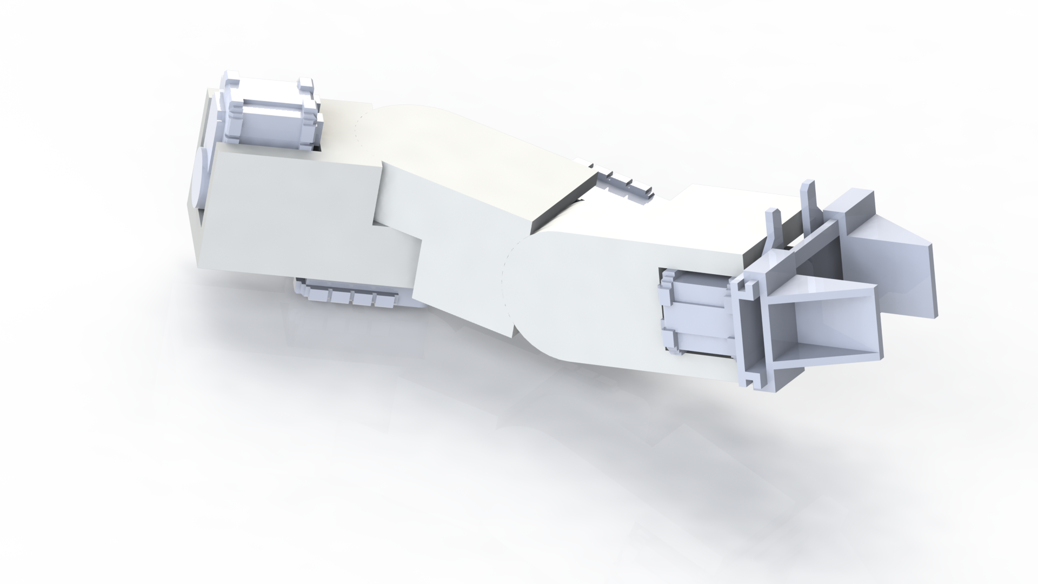
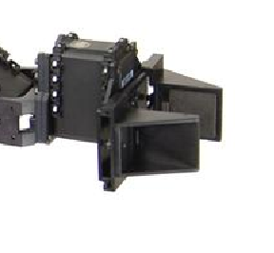
Manipulator
2 Flying voltage probes
Simple parallel gripper
3 Axis servo actuated wrist joint

Slide 17
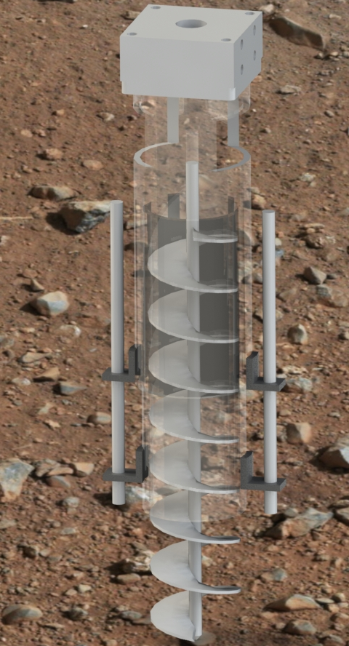
Soil Sampling Task
Drill to a depth of 2.5 cm
Collect sample from said depth
Conduct field test for life as well as lab test.
Transport sample to home base.

Slide 18
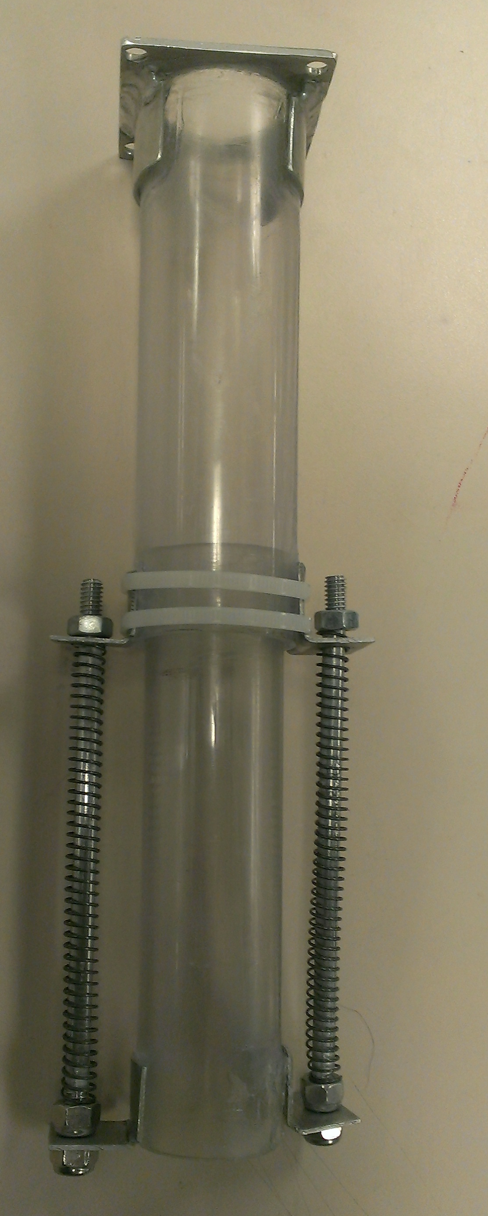
Soil Sampling Tool
Custom polycarbonate, spring loaded housing, for its light weight and durability.
Standard 1 1/4in by 8in auger bit ideal for collecting sand quality soil.
Powered by a Banebots RS555 drive motor connected to a Flexi Drill.

Slide 19
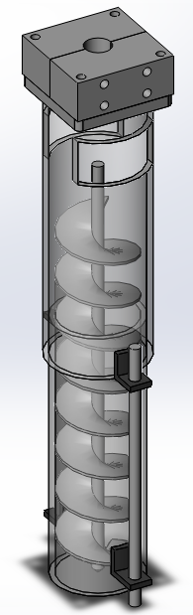
Soil Sampling Task
Can drill and collect soil samples up to 5 in.
The bit combined with the housing can transport samples.
An onboard test must be completed in addition to a test back at the base station.

Slide 20
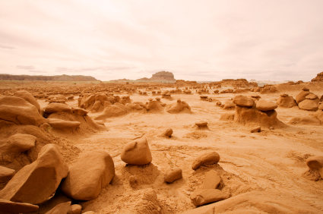
Soil Sample Testing
Desert
Harsh environment.
Not a lot of water.
What can live there?
Lichens.
Cyanobacteria.

Slide 21
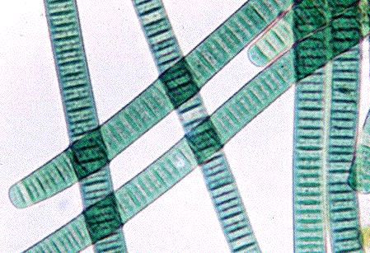
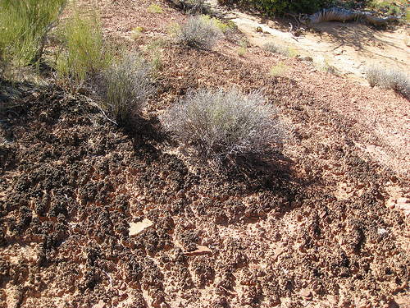
Soil Sample Testing
Cyanobacteria (Blue-green algae)
Watery environment.
Desert.
Cryptobiotic.
Just add water!
How to find them?
Cryptobiotic soil crusts.
Within the top 6-8 inches of soil.
Must be undisturbed.

Slide 22
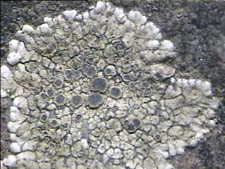
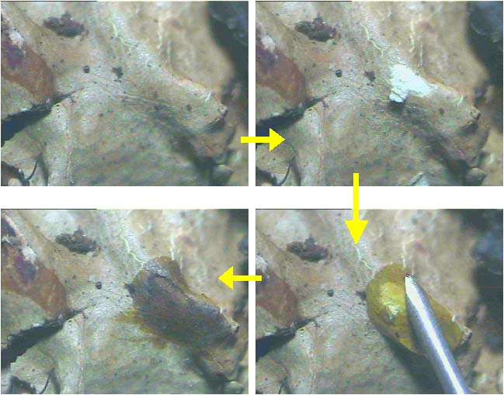
Soil Sample Testing
Lichens
Alga and fungas.
All regions in the world.
How to find them?
Desert varnish.
Discoloring.
Color spot test.
Potassium hydroxide (K-test).
Calcium hypochlorite (C-test).
Paraphenyldiamine (Pd-test).

Slide 23
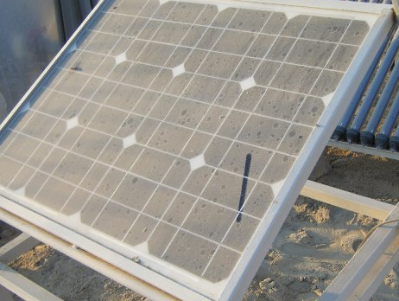
Solar Panel Cleaning Tool
Design Considerations
Keep weight low.
Reliability.
Performance.
Cost.

Slide 24
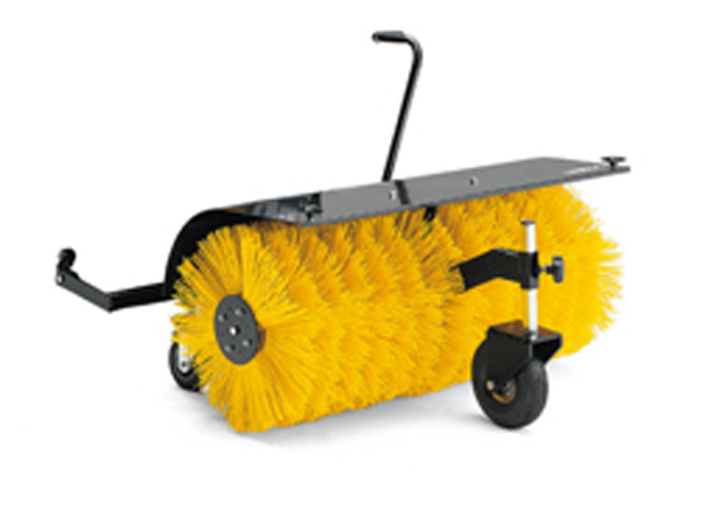
Design Idea #1
Solar Panel Cleaning Tool
Pros
Rotary brush, its super effective.
Efficient.
Fast.
Cons
Complex.
More possible failure points.
Notes:
http://www.franknicol.co.uk/product_images/c/13_0977_61__79287.jpg

Slide 25
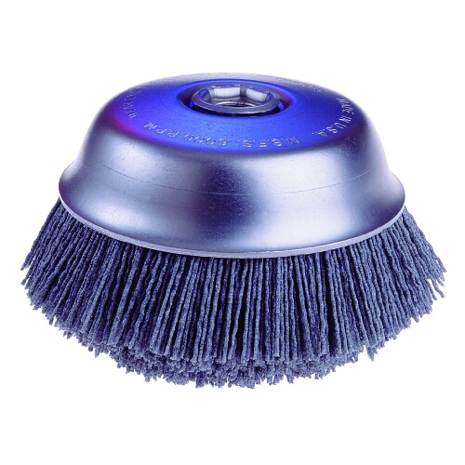
Design Idea #2
Solar Panel Cleaning Tool
Pros
Simple.
Fewer points of failure.
Cons
Lower efficiency.
Not as effective.
Notes:
http://www.erindustrial.com/images/zerimages/500/OSB-32125HR.jpg

Slide 26
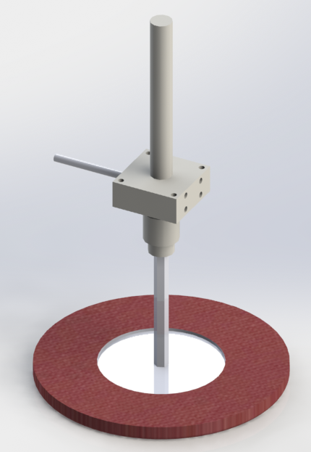
Design Idea #3
Solar Panel Cleaning Tool
Pros
Simple.
Moderate points of failure.
Previous semester design, Few changes needed.
Cheap.
Cons
Low efficiency.
Not as effective.
Notes:
http://www.erindustrial.com/images/zerimages/500/OSB-32125HR.jpg

Slide 27
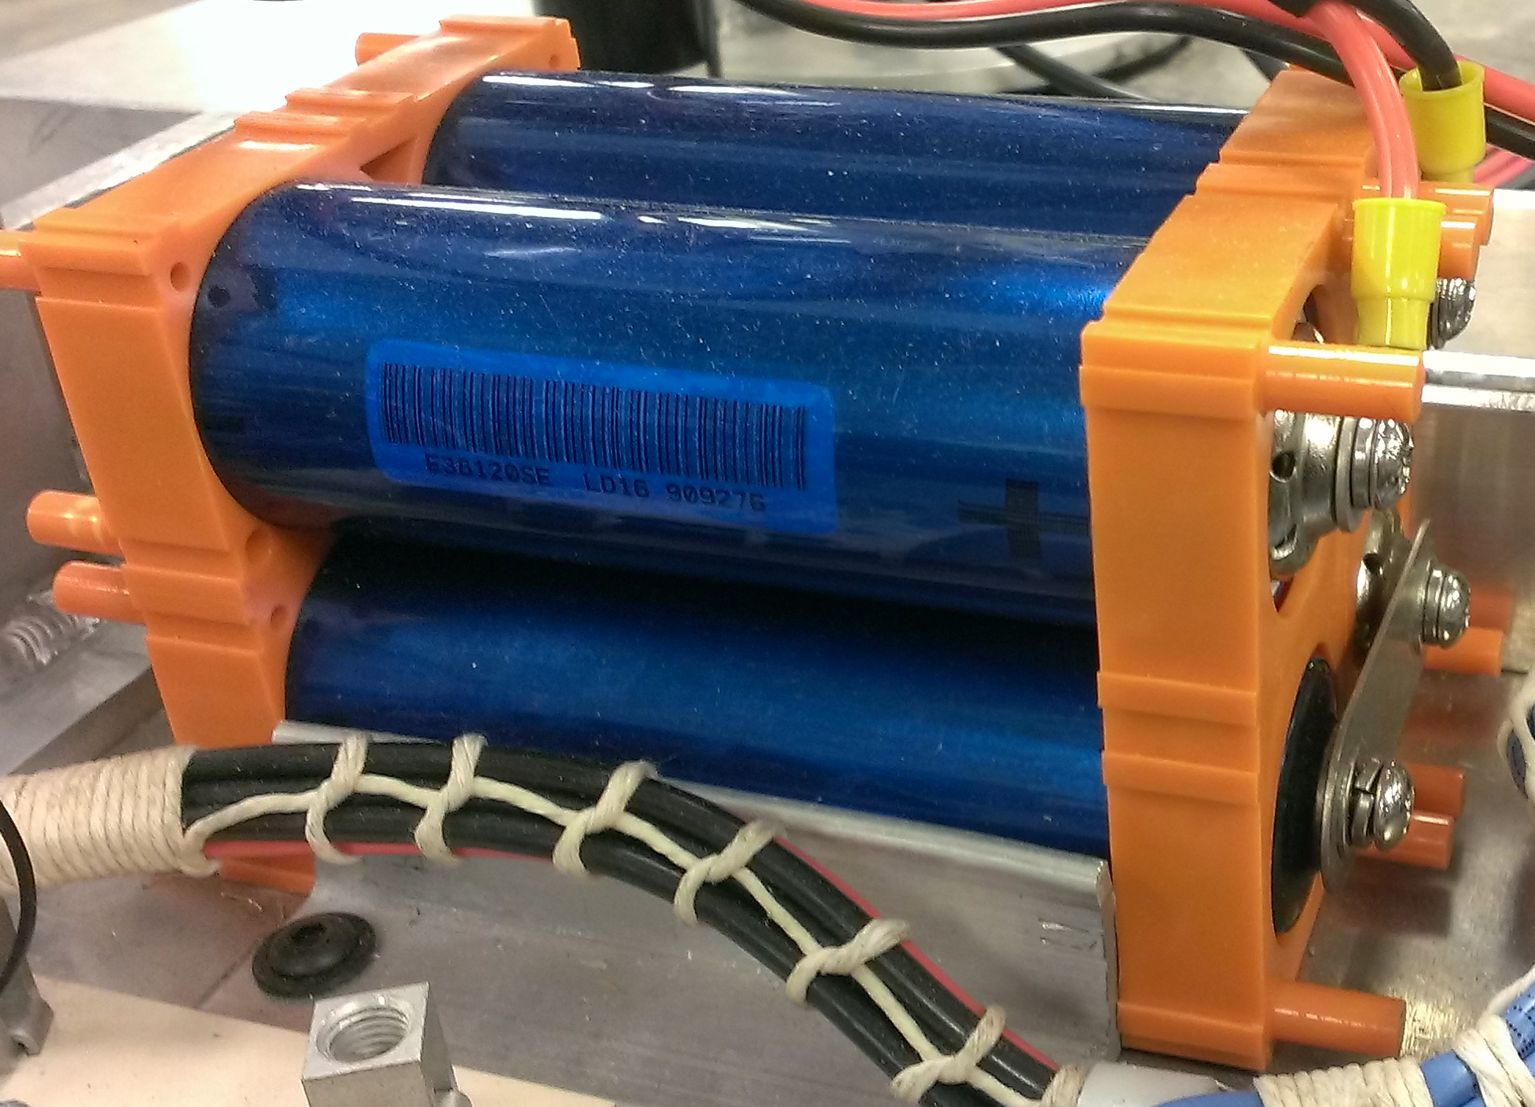
Power
Custom lithium polymer battery packs for increased energy density.
Designed to support 50 A sustained current draw.
20 Ah minimum capacity.
12.8 V lithium iron chemistry.

Slide 28
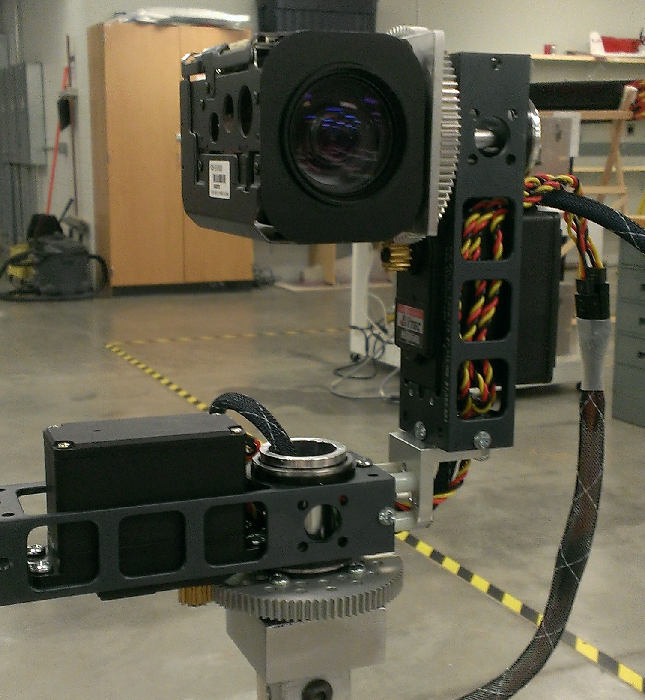
Sensors and Feedback
GPS: Garmin 18x
Camera: Sony FCB-EX1020 36x zoom mounted on pan/tilt mount
Communication through serial interface with ChipKit development board

Slide 29
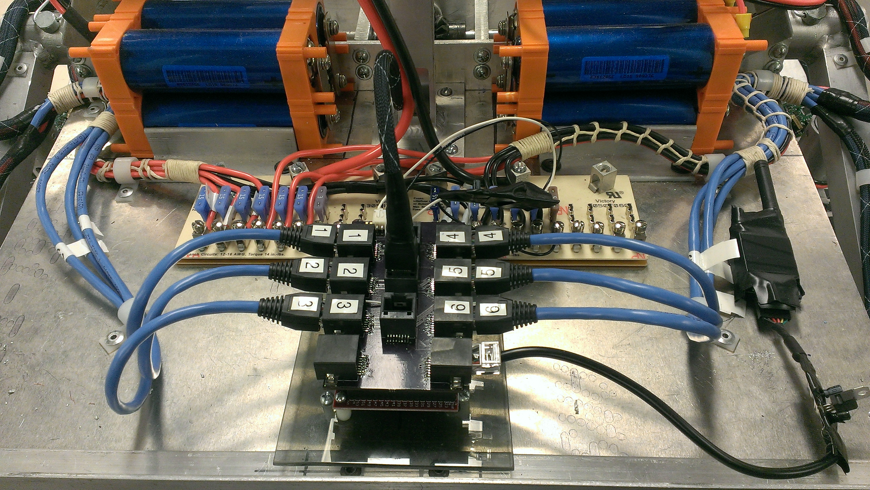
Control System Design
ChipKit MAX32 central control board
Fuberino Mini used for camera movement control
Arm control also using ChipKit MAX32
Communication through serial interface with the central control board

Slide 30
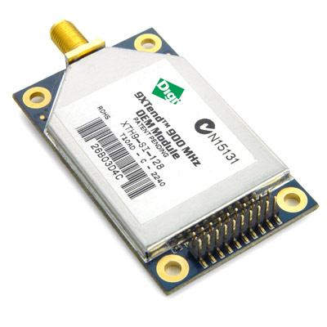
Wireless Communication
Data Link: 1W 900MHz RFD900 wireless serial modem
Video Link: 1w 2.4GHz Amateur TV transmitter
Fiberglass mast to elevate antennas at base station
6dBi Duck antenna minimum on rover
6dBi antenna minimum at base station

Slide 31
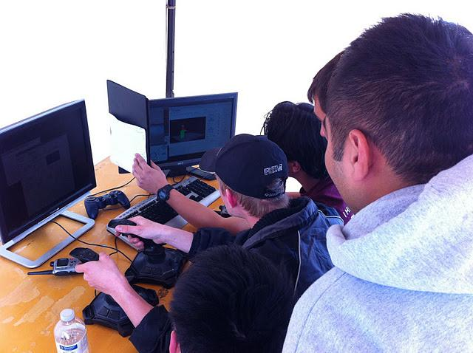
Base Station Control
Standard 110v power is supplied at competition
25 minute setup period and 15 minute tear down
Laptop preferred
Video display via capture card or TV monitor
Control software is being written in Python

Slide 32
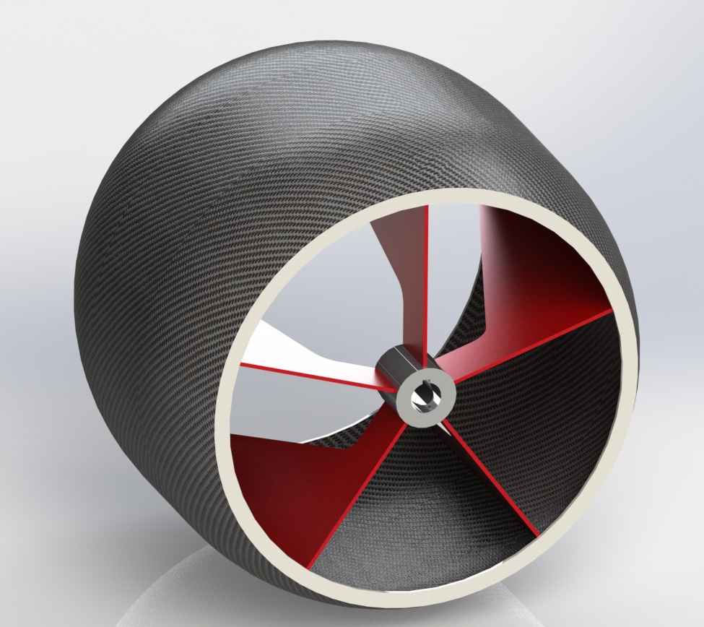
Future Plans
Redesign subsystem components
Redesign Gearbox
Redesign Suspension
Fabricate new subsystems
Fabricate new gearbox
Fabricate new suspension
Program arm controls
Program new driving style
Thoroughly test

Slide 33
Updated Budget
Registration: $100
Communications: $150
Gearboxes: $300
Motors: $200
Suspension: $300
Wheels:$150
Misc: $400
Total: $1600
Travel: $1500
Lodging: $1000
Budget reduced through prospective sponsors:
Digi-Key - electronic component discounts
Advanced Circuits - free circuit boards
Vermeer - Donation of $2000
Total Funding: $3,300
Spent: $200
Travel: Estimated $2500

Slide 34
Updated Timeline
Redesign
Suspension redesign – Nov. 13
Payload redesign – Dec. 13
Wheel redesign – Nov. 13
Differential redesign – Dec. 13
Arm components redesign – Dec. 13
Gearbox redesign – Nov. 13
Soil Sample tool design – Dec. 13
Solar Panel tool design – Dec. 13
Fabrication
Subsystem fabrication – Feb. 14
Suspension fabrication – Feb. 14
Testing/Driver Training
Subsystem fabrication – Feb. 14 to May 14

Slide 35
Questions?

Slide 36
Sources
http://perceptivetravel.com/issues/0108/photos/northam_utah.jpg
http://ccwce.mit.edu/var/ezwebin_site/storage/images/news-events/photo-gallery/2011-ccwce-s-desalination-technology/ronan-r4-pv_panel_-_dust_covered/3876-1-eng-GB/Ronan-R4-PV_Panel_-_Dust_Covered.jpg

